Slide 1
Olympics Database Analysis
April, 2022
Sumita Pathania

Slide 2
Which Client/Dataset did you select and why?
I have selected Client 3: SportsStats (Olympics Dataset - 120 years of data)
  This dataset contains 271,116 samples in total.
  Each sample has age, height weight, year, sport, country, medal, and so on.
Based on our analysis, they might be able to get interesting findings regarding Olympic medalists and athletes. This information should provide insight into how an athletic organization in each country can improve the performance of their members in order to get a good results in the Olympic.

Slide 3
Who are you presenting to?
Women sports groups
Sport News Agencies

Slide 4
Why do you want to present to this audience?
I want to Analyse how female are performing in Olympics games and their interest has risen in past few years, Women Sports groups need to know this inorder to provide better facilities to female atheletes.
Also, I want to present my analysis to News reporting agencies so that they can present their views to their audience.

Slide 5
Question?
Change in Participation and Performance of Female Athletes Over Time?

Slide 6
Initial Hypothesis
Participation of Female athletes have improved over time.
Performance of Female athletes have improved over time.
Female athletes from top 5 Host countries have better performance and participation.

Slide 7
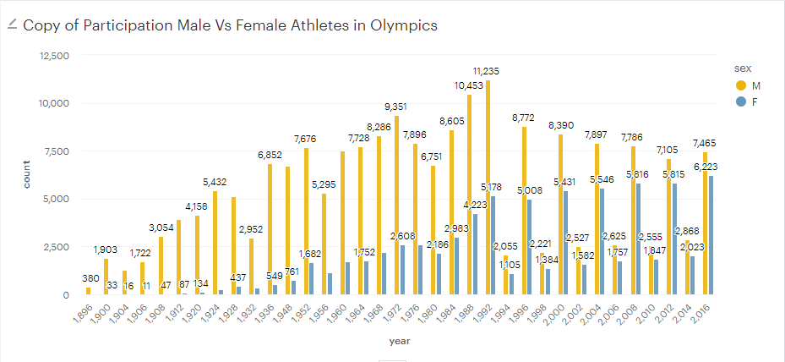
Participation of Female athletes have improved over time?

Slide 8
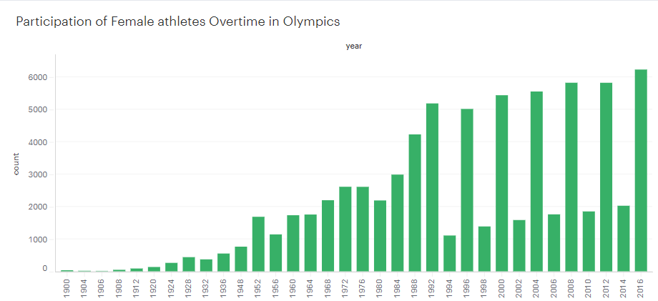

Slide 9
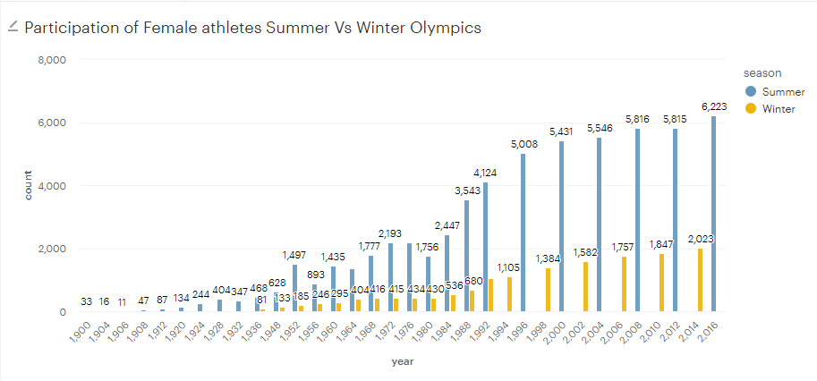

Slide 10
Conclusions..
We can safely say based on earlier results; Participation of Female athletes compared to Male Athletes have drastically improved over past few years.
We can see a drastic change around year 1952 after which participation steadily increased and then in 1992 after which again there was steady increase in participation.
More women athletes Participate in summer Olympics.

Slide 11
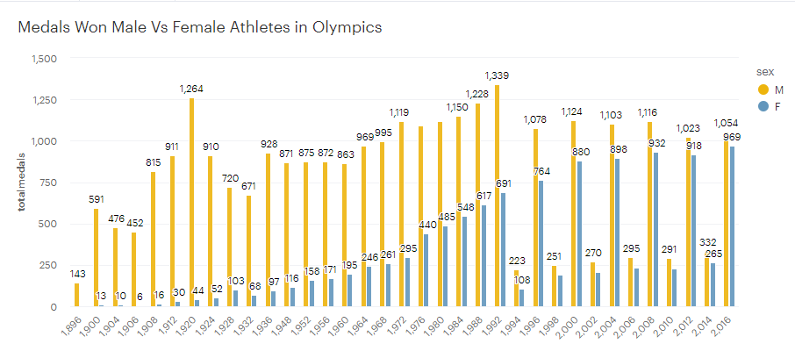
Performance of Female athletes have improved over time?

Slide 12
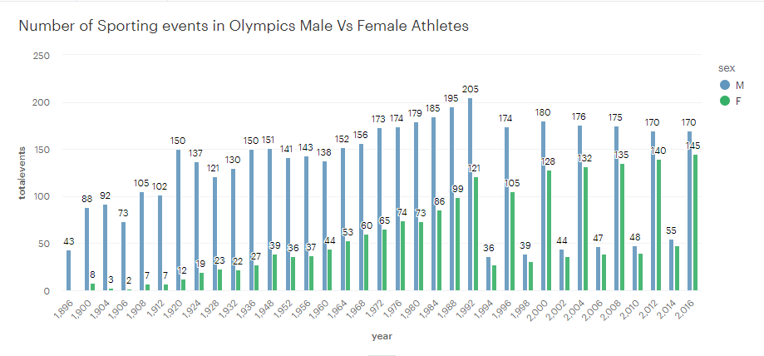

Slide 13
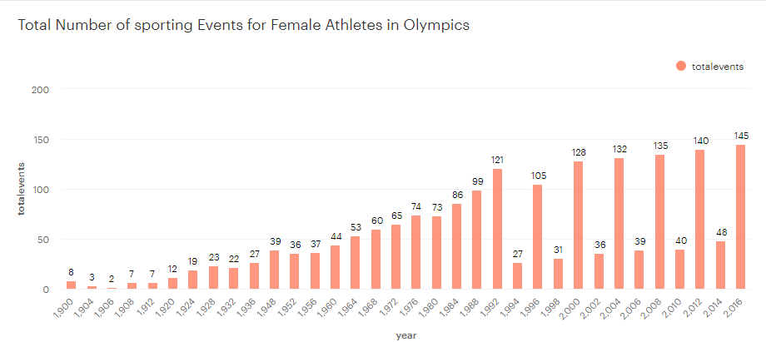

Slide 14
Conclusions..
We can safely conclude Performance of Female Athletes have consistently Improved in Olympics in recent years.
We can safely assume Olympic committee is aware of increased interest of Female athlete group and are taking measures to promote and support this group as they increased number of sporting events in Female category.

Slide 15
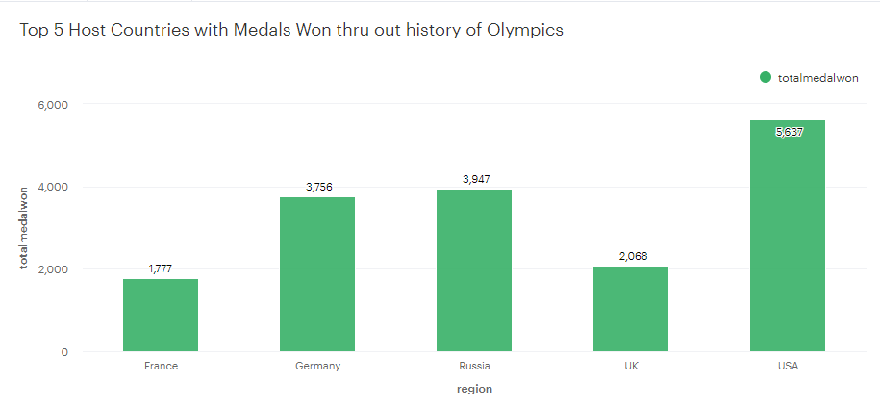
Female athletes from top 5 Host countries have better performance and participation?

Slide 16
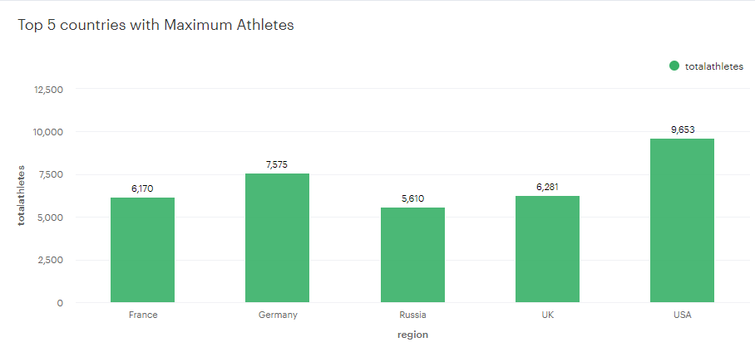

Slide 17
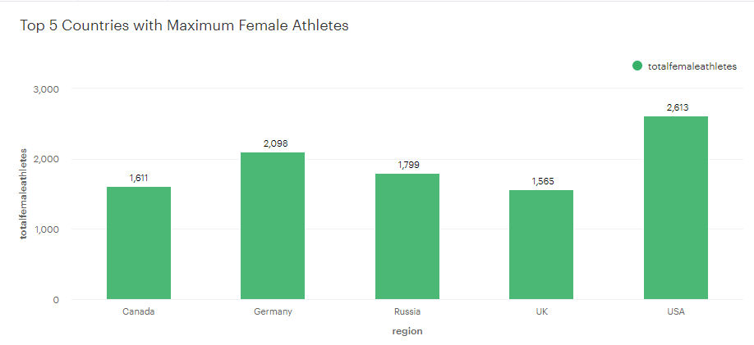

Slide 18
Conclusions..
Top 5 Host Countries have Won Maximum number of Medals thru out History of Olympics which could be because of familiarity with Home grounds and supporting crowds.
These Countries also have Maximum number of athletes participating thru out history of Olympics. Which Could be because they hosted Olympics and created Interest in people to pursue sports as career.

Slide 19
Conclusions Conti..
Top 4 Host Countries again show up with Maximum Female athletes Participating.
What was interesting to note here was Canada is a Host country that shows up in top 5 when it comes to number of Female athlete participating in Olympics.
This shows Canada is really promoting Sport as career for their Female population and providing facility to get more Females in sports.

Slide 20
Success of Female Athletes Vs Male Athletes
I have created a new Metric Gender Binary, to Figure out which group is performing better than other.
According to my analysis Male athletes participated in Total of 196594 Events and they won in total of 28530 Medals whereas Female athletes Participated in 74522 Total Events and won 11253 Medals.

Slide 21
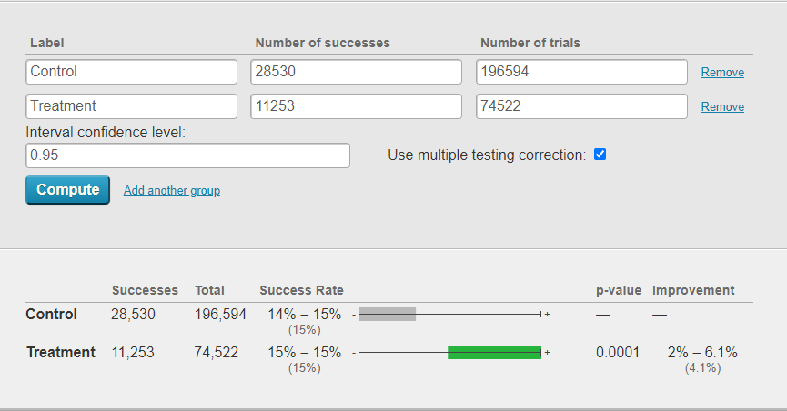
Success of Female Athletes Vs Male Athletes

Slide 22
To Conclude, Not only Participation but Performance has also Improved in Female athlete group when we compare it to Male athlete Group. We see positive lift of 4.1% in performance of Female athlete Group when compared to Male Athlete Group.

Slide 23
Recommendations and Actions
I would recommend, My Clients to Provide facilities to Female athletes so that they can look forward to their Career in Sports.
Also, News agencies can report on increasing interest of Females in Sports and create awareness to get more Women in Sports.

